Slide 1
Flight Arrival & Delay Analysis
By
Pranav Suklal Chavan
Rutwik Sanjay Guntoorkar

Slide 2
Introduction
We will be analyzing the Flight Arrival & Delay Data in United States from January 2004 to December 2019. These visualizations follow the analysis of Flight arrival performance, delay causes, and delay times of various domestic and commercial airlines on a monthly basis.
We will be studying some interesting virtues of data to get analysis on following questions :
i) Flight arrival performance over the years?
ii) What is the top cause for delays over the years?
iii) Do the delays follow a seasonal trend?
We will be using Tableau and MS Excel to analyze and get insights from the data. In the following slide, we will be introducing the variables of interest in our data.
Data Source : https://www.transtats.bts.gov/OT_Delay/OT_DelayCause1.asp

Slide 3
The variables of interest are as follows:-
Arrival Delay: Difference in minutes between scheduled and actual arrival time. Early arrivals show negative numbers.
Air Carrier: The cause of the cancellation or delay was due to circumstances within the airline's control (e.g., maintenance or crew problems, aircraft cleaning, baggage loading, fueling, etc.).
Extreme Weather: Significant meteorological conditions (actual or forecasted) that, in the carrier's judgment, delay or prevents the operation of a flight such as a tornado, blizzard, or hurricane.
National Aviation System (NAS): Delays and cancellations attributable to the national aviation system that refers to a broad set of conditions, such as non-extreme weather conditions, airport operations, heavy traffic volume, and air traffic control.
Late-arriving aircraft: A previous flight with the same aircraft arrived late, causing the present flight to depart late.
Security: Delays or cancellations caused by evacuation of a terminal or concourse, re-boarding of aircraft because of a security breach, inoperative screening equipment, and or long lines over 29 minutes at screening areas.

Slide 4
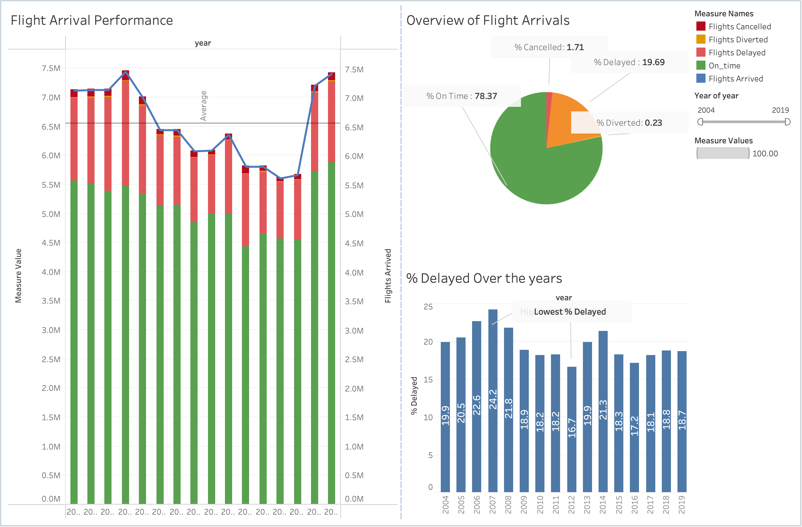
Analysis
Let us look at how the number of flights arriving at airports in the USA has changed from 2004-2019.
In the following visualizations we can see that from 2004-2008 over 7 million flights arrived every year with 2007 being the peak with 7.46 million flights arriving that year.
From 2004-2019 most flights also arrived in 2007 with 2019 coming in close 2nd with 7.42 million flight arrivals.
The number of flight arrivals did not cross the 6.5 million mark from 2009 to 2017 with the Least number of flight arrivals in 2016 (5.62 million flights arriving).
Looking at the delay values over the years, it is observed that 2007 had the highest delays and 2012 had the lowest values.

Slide 5
Let us now see the state-wise distribution of flight arrivals in the visualization below. Here we can see California has the highest number of arrivals closely followed by Texas and Delaware has the least number of arrivals.

Slide 6
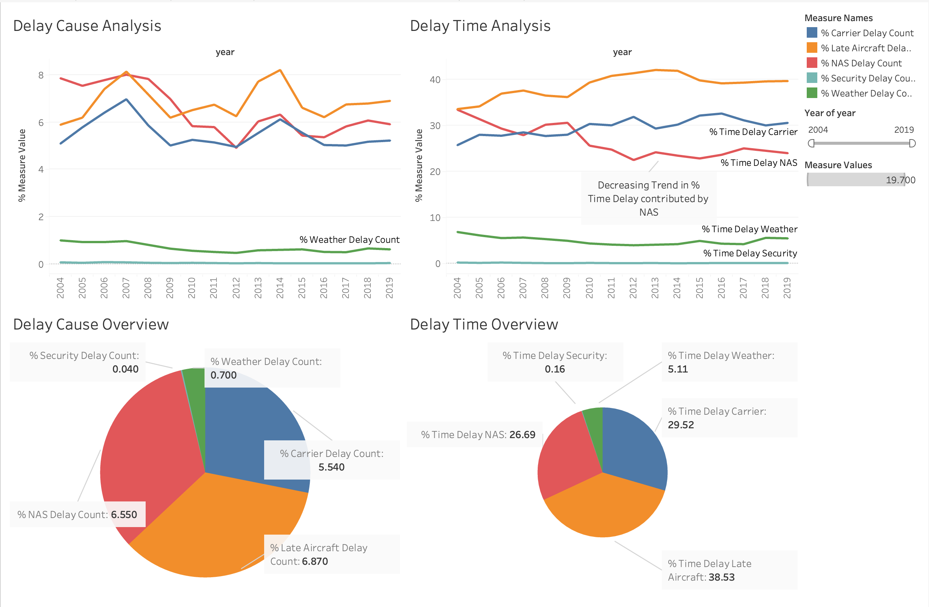
The next visualization will dive into delay cause and delay time analysis.
Both delay count and delay time due to NAS have decreased compared to the previous decade, which includes non-extreme weather conditions, airport operations, heavy traffic volume, and air traffic control.
Delay Time is on a decreasing trend through 2019.
Flights delayed due to Late Aircraft is the primary cause and contribute the most to the delay time.
Delay time due to Late Aircrafts is surging.

Slide 7
Now let us look at the seasonal trend in % of flights Delayed.
Peak delays occur in December with 23.7 % of the total flights being delayed.
December is when the holiday season and harsh winter clash and overburden the commercial flight network.
Delays are on the lower end in September, October, and November with only 15% of the flights being delayed in September.

Slide 8
Conclusion
These visualizations have explored Flight arrival performance and delays in the USA from 2004-2019. We have produced following insights from our analysis:
The visualizations revealed various trends and key insights from the dataset such as the slump in flight arrivals from 2009-2017 and the gradual decrease in the number of flights delayed over the years.
Moving on to the delay causes and how those causes contribute to the overall delay time it is observed that Late Aircraft delay was the major reason for flight delays in the USA which also led to this cause being the top contributor to delay time.
The time delay associated with NAS delays (non-extreme weather conditions, airport operations, heavy traffic volume, and air traffic control) is gradually decreasing over the years which can be due to an increase in the efficiency of airports.
The last visualization explored the seasonal trends in % of Flights delayed. December had the highest amount of delays as is the holiday season and peak winter in the country while September – November, the least delay, was observed over the years.

Slide 9
Thank You!

